Slide 1

World Wide Energy Consumption Analysis
By
Yogita Rajesh Dhamale

Slide 2
About me
I Have Completed my MSC in Statistics From Modern College Of Arts, Science and Commerce , Pune
I am learning data analytics because it helps convert raw data into useful insights for decision-making. It is a high-demand skill with strong career opportunities and applications across many industries.
LinkedIn profile URL : www.linkedin.com/in/yogita-dhamale-b151a2219
GitHub profile URL : https://github.com/Yogi14-93

Slide 3
Agenda
Objective of the Project
ER Diagram and schema explanation
Key analysis questions (use cases)
SQL query results with screenshots or summaries
Final business insights and recommendations
Conclusion (Key finding overall)
Experience/Challenges

Slide 4
Objective
The main objective of this analysis is to understand how energy is produced, consumed, and distributed across different regions and sectors.
Identify which energy type contribute most to overall emission.
To identify the top countries by GDP.
To know the emission changes over the years.

Slide 5
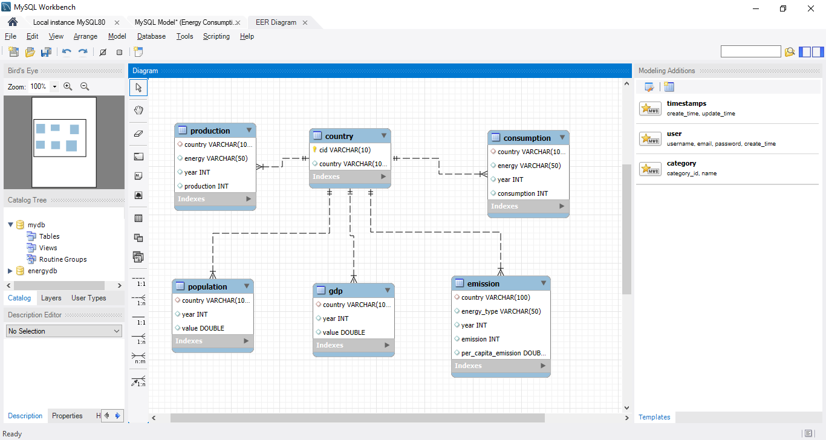
ER Diagram

Slide 6
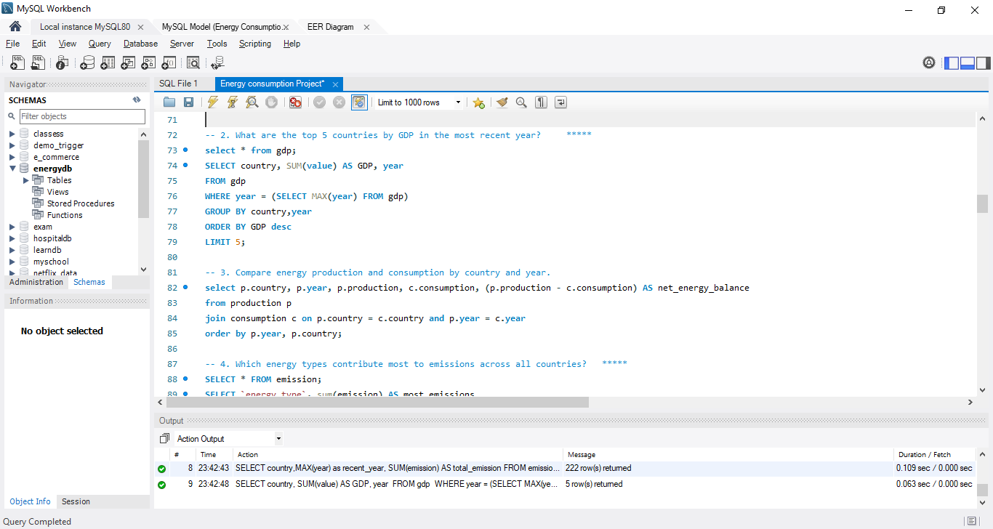
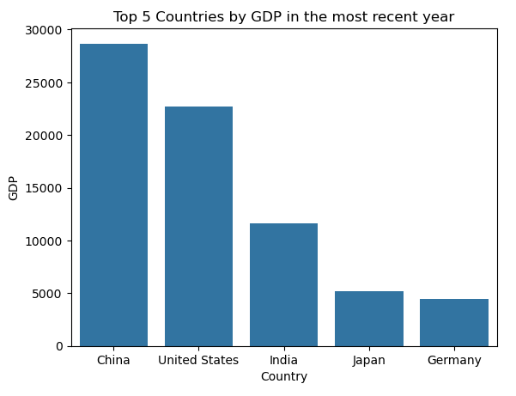
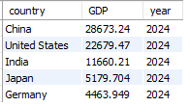
Top 5 countries by GDP in the most recent year
China is a top-most country by GDP, followed by US, India Japan & Germany. Because in china production is more.

Slide 7

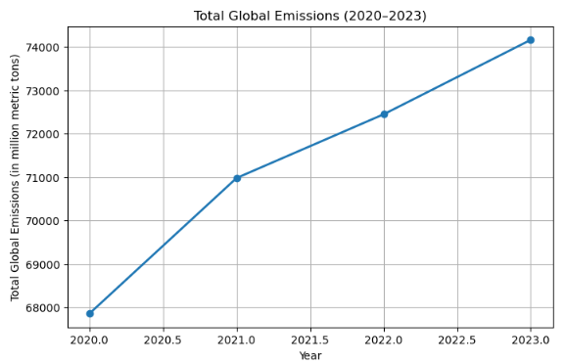
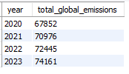
Global emissions by year
The line chart shows a consistent rise in total global emissions from 2020 to 2023.
Emissions increased from 67,852 units in 2020 to 74,161 units in 2023.

Slide 8

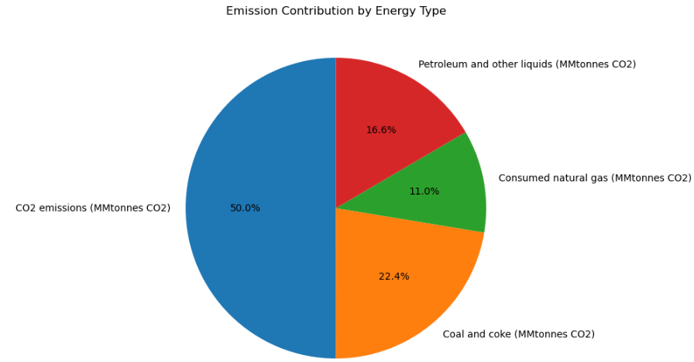

Emission contribution by Energy type
CO2 account for a major portion of the emissions, indicating that they are the most polluting sources.
In contrast, energy types with smaller proportions contribute comparatively less to emissions

Slide 9
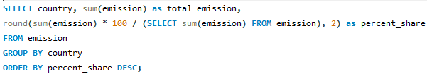
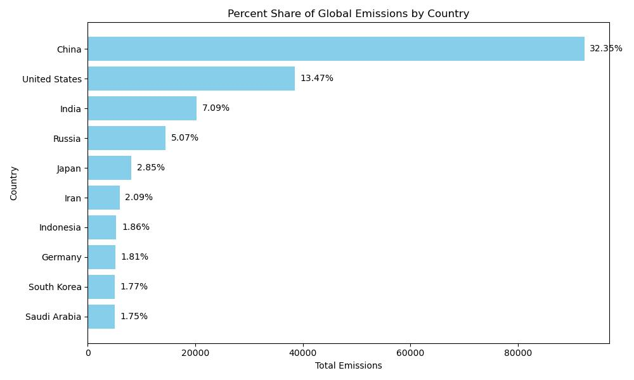
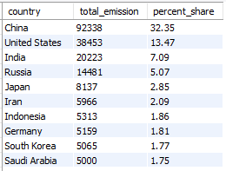
Global share (%) of emissions by country?
China contributes the largest share of global emissions, accounting for over 32% of total global emissions.
The United States is the second-largest emitter with 13.47%, followed by India at 7.09%.

Slide 10
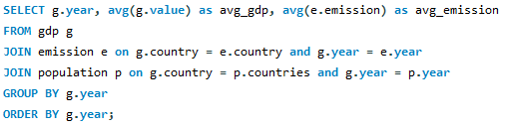
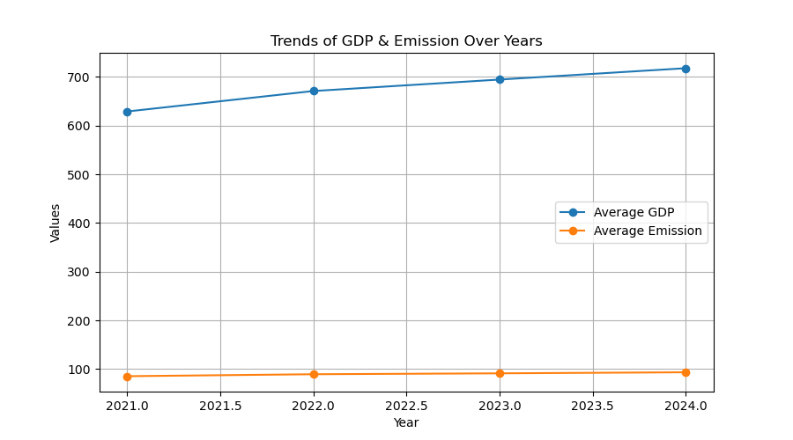

Global average GDP and emission by year
Average GDP increases steadily over the years, indicating economic growth.
Average Emission also gradually increases at a much smaller scale, suggesting a slow growth in emission levels relative to economic growth.

Slide 11
Conclusions
Global energy use and CO₂ emissions are increasing every year.
China, the United States, and India are the top contributors to global emissions.
Fossil fuels are still the major source of energy, leading to high carbon emissions.
To reduce emissions, countries need to: Increase the use of renewable energy (solar, wind, hydro).
China and the United States show consistently high energy consumption, indicating strong industrial and economic activity.
India shows a steady upward trend, meaning rising energy needs due to population and economic growth.

Slide 12
Experience and Challenges
Experience:
Understood how to join and integrate tables
Understood global energy usage patterns.
Challenges:
Understanding real-world context behind trends (economic growth, policies, population impact).
Handling large datasets
Running queries(Grouping, Aggregation, Joins)

Slide 13

THANK YOU

